Slide 1
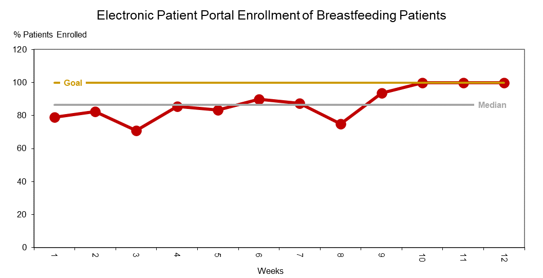
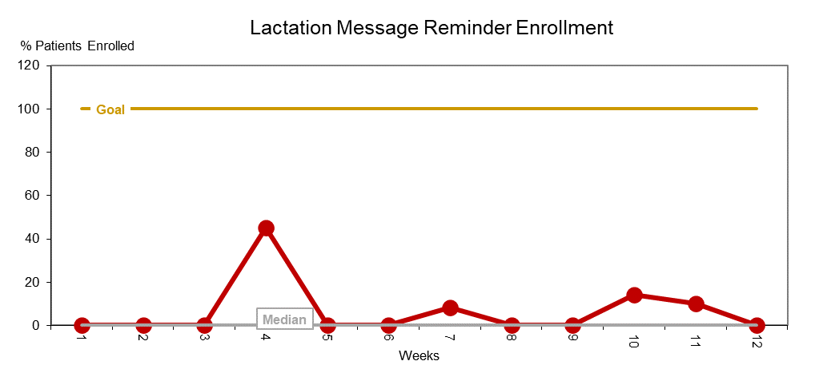
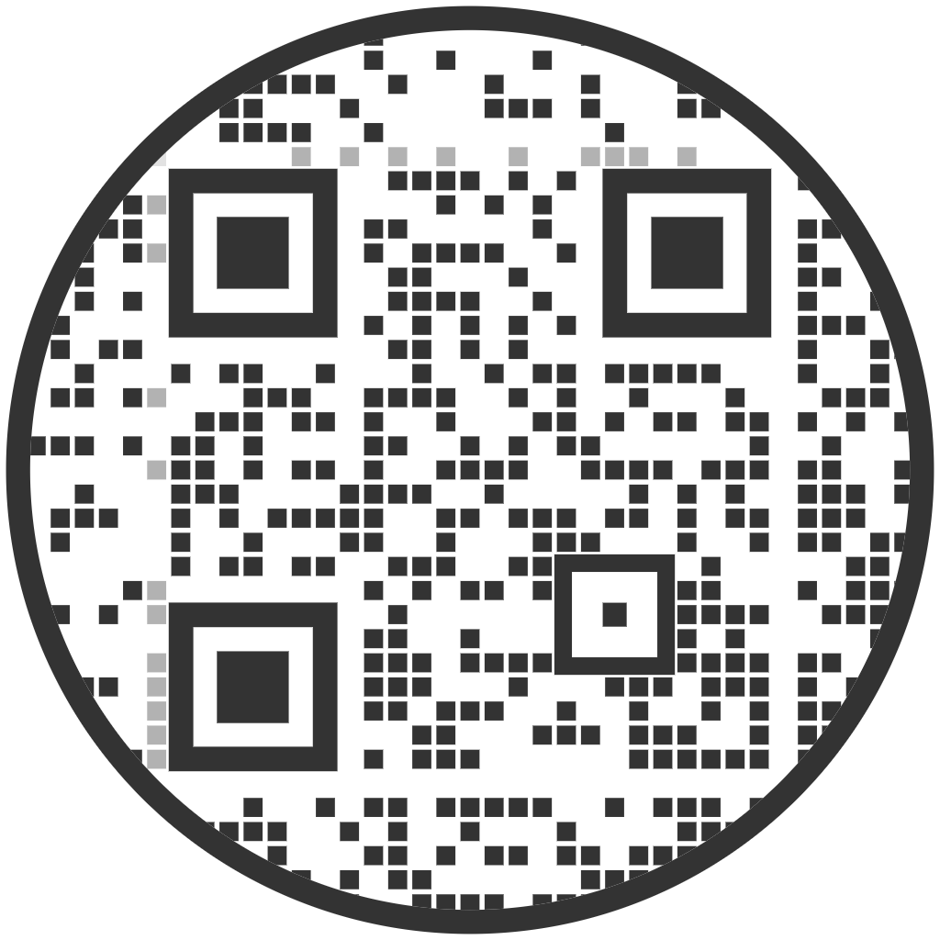
Integration of Lactation Messaging and Resources
in the Patient Portal
Emma Varner, BSN, RN; Mary Ellen Connolly, DNP, CRNP
Shari Simone, DNP, CRNP, FCCM, FAANP
University of Maryland School of Nursing
Problem Statement
Results
Conclusions
Breastfeeding has many benefits
Approximately 47% of infants are breastfed at discharge, below site’s goal of 80%
Lactation support groups and messaging with lactation consultants increases breastfeeding rates and duration
Site has low engagement with lactation support groups
EPP enrollment and lactation reminders may increase patient engagement, breastfeeding duration
Increased patient engagement may improve maternal and infant outcomes
Implications
Purpose of Project
Integration into EMR and EPP for sustainability
Availability of lactation resources in multiple languages in EPP
Research on EPP engagement and breastfeeding duration
Examine additional barriers to lactation support group
To implement and evaluate lactation messaging, resources, and support group information into the electronic patient portal (EPP) to improve lactation support after discharge
Next Steps
Short term goals: 100% of breastfeeding patients will:
attend the virtual lactation support group
enroll in the patient portal
enroll in lactation support reminders
Long term goal: 100% increase in breastfeeding dyads at 6 months
Methods
Setting: 22-bed Mother Baby Unit, 25-bed Labor & Delivery Unit at an urban academic medical center
Population: Breastfeeding mother infant dyads discharged from a medical center in Baltimore City
Intervention:
Identified patients (breastfeeding, > 35 weeks gestation) and assessed interest in support, EPP
Electronic support group reminders via EPP
Lactation guides accessible in the EPP
Implementation Measures & Strategies:
Measures:
Lactation consultant education
Electronic medical record changes
Lactation enrollment-messaging
Support group attendance
Strategies:
Cyclical small tests of change
Tailor strategies
Alter incentive, reexamine implementation
Discussion
https://pixabay.com/photos/breastfeeding-mother-motherhood-2428378/
Support group attendance did not increase with interventions
Over 12 weeks, 9 patients enrolled in support group reminders
Patient portal enrollment of breastfeeding patients increased from 75% to 100%
Limitations:
Virtual lactation support group
Decreased breastfeeding incidence at site during pandemic
Lactation survey and messaging not initially available in multiple languages
Completed at one site on two units
Resources & References
Resources
References
Acknowledgements
The author would like to thank Hayley Hoffman and Kate McGivern for their assistance throughout implementation.

