Slide 1
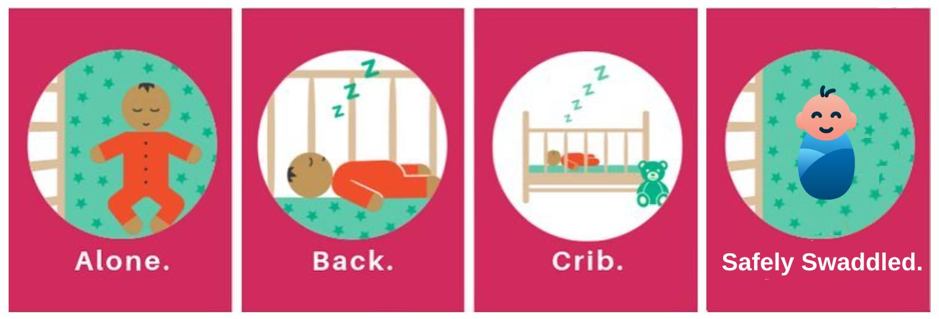
Improving Safe Sleep Practices in a
Pediatric Intensive Care Unit
Marinela Babich, BSN, RN, CCRN Shari Simone, DNP, CPNP-AC,FAANP, FCCM, FAAN
University of Maryland School of Nursing
Problem Statement
Results
Discussion
Sudden Infant Death Syndrome (SIDS) is the leading cause of infant mortality in the US. 3500 infants die due to sleep-related deaths every year
The average SIDS rate in Baltimore City from 2015-2017 was 127.5 per 100,000 live births compared to the national average of 37.5
Safe sleep practices (SSP) are recommended in inpatient units
Only 40% of infants were found to be in a safe sleep environment in a Pediatric Intensive Care Unit (PICU)
SSP in the hospital mean:
SSP eligibility screening was done on 91% of randomly audited records (n=224)
Over 15 weeks, a median of 30% were eligible for SSP (n=71)
Overall adherence to SSP increased from a pre-intervention of 25% to a post-intervention of 100%.
Assignment of video education for caregivers improved from 29% to 80%
Overall SSP improved
Screening, documentation, and designated storage contributed to improved adherence
Staff were hesitant to practice SSP due to aspiration risks
Adherence improved after guidelines were modified to exclude post-cardiac surgery patients and those with increased aspiration risks
A non-nursing champion helped improve caregiver education
Barriers and Limitations
Delay in the launch of EHR interventions
Implementation climate due to COVID-19
Findings specific to population and setting
No information on patient demographic (patient diagnosis, age), items left in crib, or reason to nonadherence to SSP
No measurement of long-term patient outcomes
The redesigned implementation was associated with the identification of fewer infants eligible for SSP in the PICU.
*
Figure 1. SSP recommendations
Conclusions
Purpose and Goals
Purpose Statement: to redesign the implementation of SSP and to evaluate the effectiveness of the interventions
Pre-Implementation
Implementation
The redesigned implementation of SSP was associated with improved adherence.
Short-term goals:
100% of infants will be screened for safe sleep eligibility
Nurses will implement SSP for eligible infants
100% of caregivers of eligible infants will receive education before discharge
Long-term goals:
SSP will be the standard of care for eligible infants
Infants discharged from the PICU will not suffer from sleep-related deaths
Implications
Modeling SSP in hospitals can help decrease sleep-related deaths in the community
Recommendations
Future goals include further improvement of caregiver education
Sustainability
Required online education module for all onboarding staff
SSP screening and documentation on EHR every shift
PICU Safe Sleep Committee and hospital-wide work group
------ Infants Screened for SSP Eligibility (n=224)
------ Infants Eligible for SSP (n=71)
*An increase in patient acuity during the implementation phase affected the number of SSP eligible infants.
Methods
Overall adherence to SSP showed an increase of 75%.
Settings and Population
19-bed PICU, infants <1 year old eligible for SSP
Data Collection
Three weeks of baseline data and twelve weeks of implementation data collected via:
Chart reviews
Crib audits
Implementation Tactics
Staff education module and quiz
Update of Safe Sleep Guidelines and Algorithm
Screening of infants for SSP eligibility every 12 hours
A Best Practice Advisory reminder for SSP orders
Documentation of SSP on electronic health record (EHR)
Designated storage space for patient care items in rooms
Communication of project updates with stakeholders
References
Acknowledgements
------ Overall SSP
------ Sleeping Alone
------ Sleeping Supine ------ Sleeping in a Crib
------ Swaddled Safely
Jennifer Arrington, MSN, RN, CNL
Jodie Austin, BSN, RN, SCNII
Mary Jo Simke, MS, BSN, RN,

