Slide 1
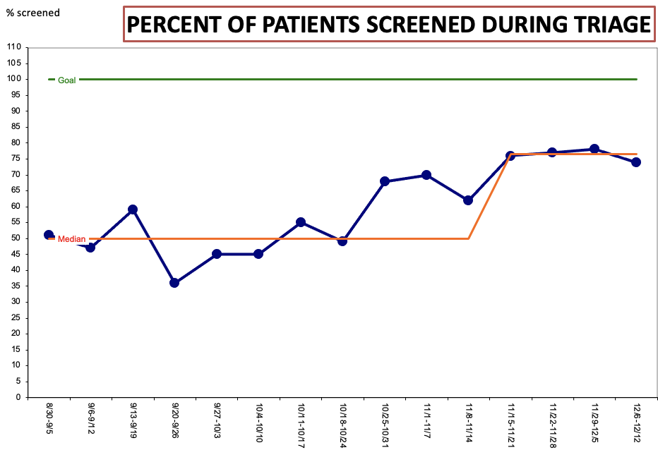
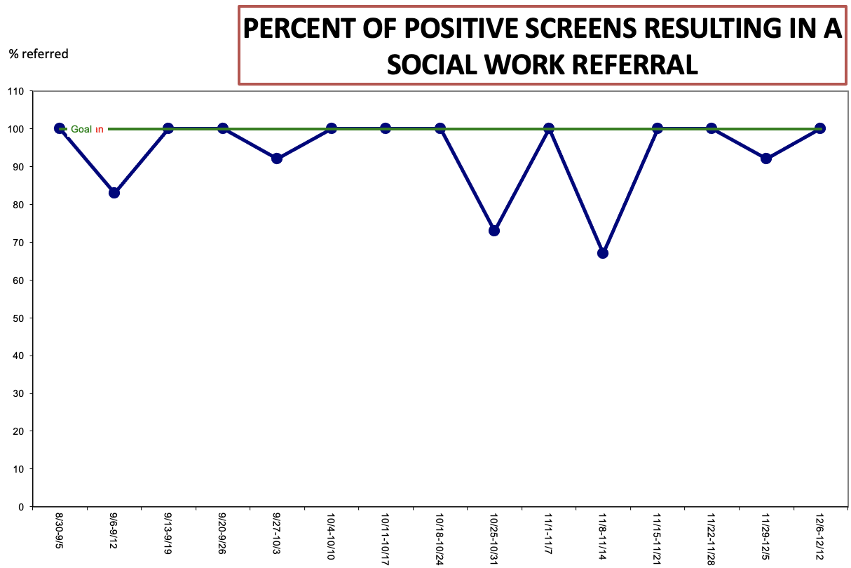
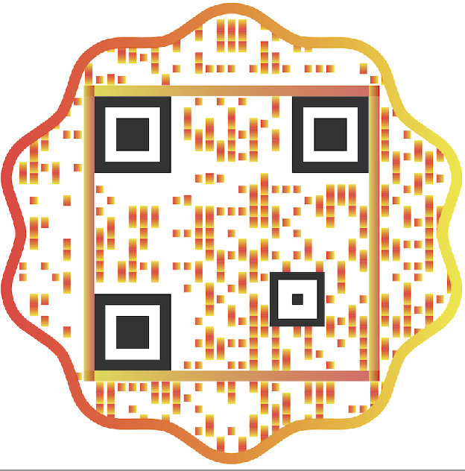
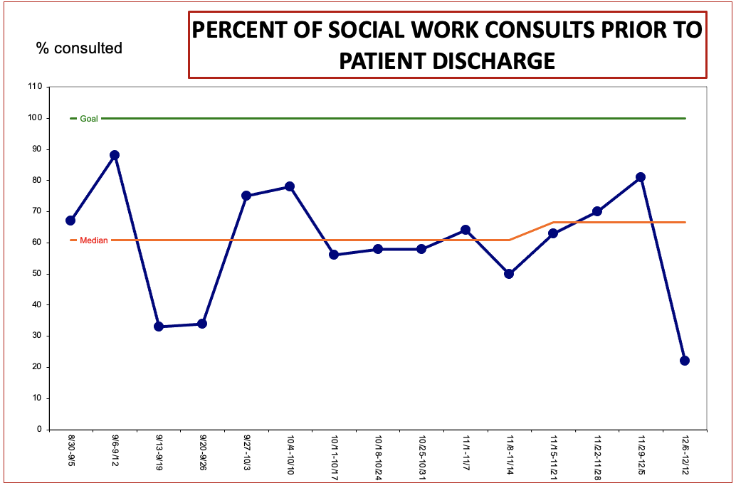
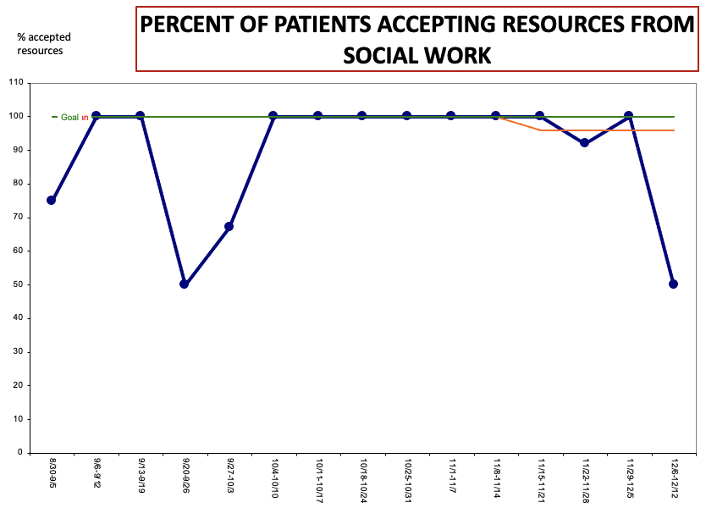
Food Insecurity Screening and Referral in a
Pediatric Emergency Department
Chelsea Shock, BSN, RN;
Rosemarie DiMauro Satyshur, PhD, RN;
Renee Franquiz, DNP, RN
Problem Statement
Results
Discussion
Food insecurity is a national public health concern often undetected in the pediatric population. It is associated with short and long–term adverse outcomes.
The U.S. Department of Agriculture’s Economic Research Service reported 38,287 (11.8%) Americans experienced food insecurity in 2020 compared to 35,207 (10.9%) in 2019.
Between 2018–2020, 9.2% of Maryland households interviewed reported food insecurity.
Evidence recommends pediatric patients receiving medical care be screened for food insecurity and connected with the necessary resources to limit associated consequences.
The Hunger Vital Sign is a validated screening tool that successfully identifies patients experiencing food insecurity.
Staff awareness of the prevalence of food insecurity reportedly improved throughout implementation.
Feedback and identification of barriers and facilitators were completed throughout the project implementation process.
Nurse and social work shortages and burnout in an inundated pediatric emergency department during a pandemic were noted to be the most significant barriers.
Communication and feedback were the most effective facilitators in promoting individual participation and project sustainability.
During project implementation, there was an increase in patient census and wait times, resulting in an increase in patients leaving prior to receiving medical care.
Patients positive for food insecurity
n=135; 7%
Eligible patients over 15 weeks
n=3,607
Patients screened
n=2,015; 56%
Purpose of Project/Goals
The purpose of this Quality Improvement project was to implement the Hunger Vital Sign, a 2-item food insecurity screening tool, into the triage process over 15 weeks in a pediatric emergency department.
The project goals aimed to identify patients with food insecurity concerns and subsequently refer positive screens to social work for resources, limiting potential adverse outcomes.
Summary/Conclusion
The Hunger Vital Sign was successfully implemented in a pediatric emergency department, identifying 7% of screened patients as food insecure.
Screening (56%), referral (94%), and consultation (60%) adherence was variable and dependent on the facilitators and barriers identified during project implementation.
Most patients experiencing food insecurity accepted resources (89%) from social work. Patients and families not accepting resources reported already having access to services.
It is recommended that the Hunger Vital Sign be incorporated as a Best Practice Advisory, a reminder tool that alerts nurses to complete the screen, in the electronic health record to promote sustainability.
Methods
The Hunger Vital Sign
Setting:
A pediatric emergency department located in an urban medical center surrounded by neighborhoods considered food deserts
Population:
All pediatric patients seeking care in the pediatric emergency department, excluding those arriving by ambulance or requiring immediate medical attention
Intervention:
The Hunger Vital Sign was completed on patients during triage by the triage nurse. Positive screens would result in a social work referral to receive resources. Screenings and social work consultations were documented in the electronic health record.
Implementation Strategies and Tactics:
Project champions, staff assessments of readiness, educational meetings, reminders, incentives, identification of barriers and facilitators, audits, and feedback were included in the implementation strategies and tactics.
References

