Slide 1
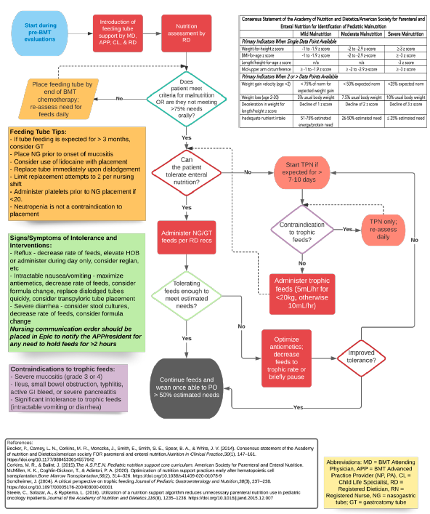
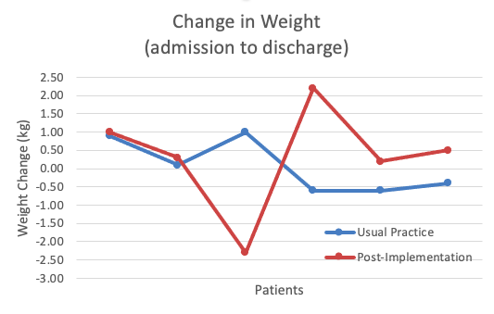
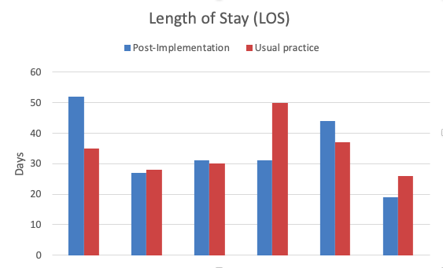
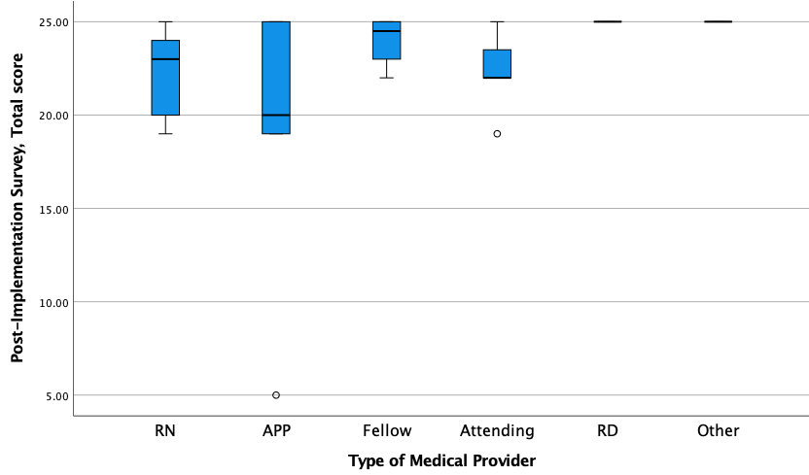
Enteral Nutrition Optimization Program for Children Undergoing Blood & Marrow Transplantation: A Quality Improvement Project
Jessica D. Murphy MS CPNP-AC CPHON CNE, Bridget VanGraafeiland DNP CRNP CNE FAAN, & Kenneth R. Cooke MD
Background
Algorithm
Discussion
Many pediatric BMT patients experience malnutrition (rates 5-50%)
contributes to morbidity and mortality
lack of standard of care measures to address
Enteral nutrition is recommended over parenteral
Shorter length of stay, less infections, decreased incidence rate and severity of acute GVHD, improved overall survival vs exclusive parenteral nutrition
High rates of malnutrition at project site and lack of protocol to address
Six patients received the intervention, with 12 total patients evaluated
No statistical differences between groups on measured evaluations
Provider sample of 45 participants fully completed the post-implementation survey
Overall feasibility and acceptance of the intervention
Increased the education that parents, patients, and staff received on importance of nutritional support and means to address
Increased use of G-tubes
Limitations: small sample size and inability to obtain MUACs due to COVID-19 pandemic, NG tube dislodgements, newly created survey
Purpose/Aims
To evaluate the impact of an evidence-based nutritional support program to optimize the use of enteral nutrition support for BMT patients aged 0-18
Aimed to address if patient outcomes were improved by interventions as well as acceptance of program by clinical staff; goal of integration into standard of care practice
Impact on nutritional status (weight loss, MUAC, malnutrition rates)
Impact on transplant-associated complications (infection rates, incidence/severity of GVHD)
Impact on transplant-related outcomes (LOS, engraftment time)
Feasibility & acceptance of interventions by clinical staff
Conclusion
A novel nutritional support program was successfully implemented to address optimizing nutritional support in pediatric BMT patients, and was noted to have high feasibility and acceptance
Resulted in overall culture shift, and increased use of NG and g-tubes
No noted clinical significance, but interpretation is limited due to small sample size
Implementation of the program has continued without gaps since project completion – new standard of care within the division
A similar program to address the nutritional support needs for the general oncology population is anticipated
Methods
Results
Participant Feasibility and Acceptability Rankings (n=45)
References
Design: Pre-post intervention design and post-implementation survey
Setting: Pediatric oncology division of an academic children’s center within a large, urban academic hospital in the Mid Atlantic
Sample: Aim 1-3 = Children and young adults (0-18y) admitted for BMT during the 16-week implementation period; Aim 4 = Clinical staff (APPs, MDs, RNs, RDs) for post-implementation survey
Measures: Aim 1 = weight change from admission to discharge, MUAC, Academy/ASPEN Consensus malnutrition criteria. Aim 2= Epic chart review of infections, GVHD using MAGIC criteria, Aim 3 = length of hospitalization, time to neutrophil & platelet engraftment using CIBMTR criteria, Aim 4 = 5 question Likert-style survey
Analysis: Mann Whitney U, Fisher’s exact, Chi-square, descriptive statistics
Participant Feasibility and Acceptability Rankings (n=45)
 | Agreed or Strongly Agreed, N %
The BMT Enteral Nutrition Optimization Program (EN-Opt) was easy to follow | 41 (91.1%)
The BMT EN-Opt increased my focus on nutritional support for our patients | 43 (95.5%)
The BMT EN-Opt helped to increase enteral nutritional support during BMT admissions | 38 (84.5%)
The BMT EN-Opt was beneficial to our patients | 42 (93.4%)
The BMT EN-Opt should be adopted as the standard of care approach for our patients | 40 (88.9%)
Evans, J. C., Hirani, S. P., & Needle, J. J. (2019). Nutritional and post-transplantation outcomes of enteral versus parenteral nutrition in pediatric hematopoietic stem cell transplantation: A systematic review of randomized and nonrandomized studies. Biology of Blood and Marrow Transplantation, 25(8), e252-e259. https://doi.org/10.1016/j.bbmt.2019.02.023
Corkins, M. R., Griggs, K. C., Groh-Wargo, S., Han-Markey, T. L., Helms, R. A., Muir, L. V., & Szeszycki, E. E. (2013). Standards for nutrition support. Nutrition in Clinical Practice, 28(2), 263-276. https://doi.org/10.1177/0884533613475822
Kerby, E. H., Li, Y., Getz, K. D., Smith, E. C., Smith, L. T., Bunin, N. J., & Seif, A. E. (2018). Nutritional risk factors predict severe acute graft-versus-host disease and early mortality in pediatric allogeneic hematopoietic stem cell transplantation. Pediatric Blood & Cancer, 65(2), e26853. https://doi.org/10.1002/pbc.26853
McMillen, K. K., Coghlin-Dickson, T., & Adintori, P. A. (2020). Optimization of nutrition support practices early after hematopoietic cell transplantation. Bone Marrow Transplantation. https://doi.org/10.1038/s41409-020-01078-9

