Slide 1
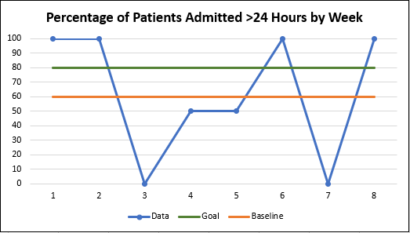
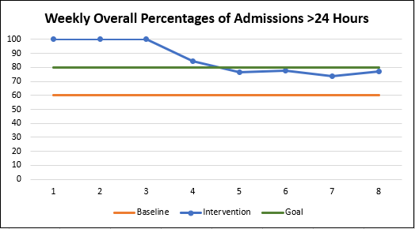
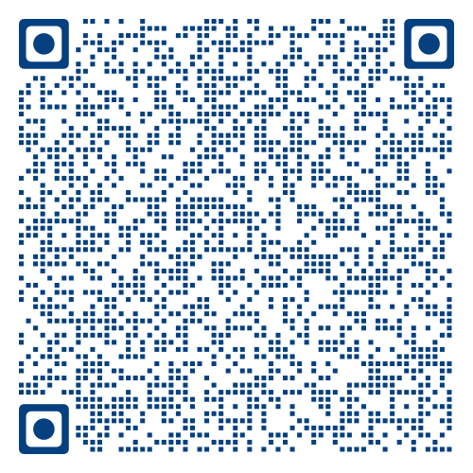
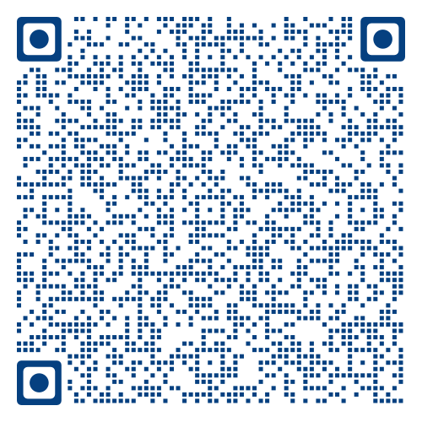
Implementation of a Pediatric Burn Occupational Therapy Pathway to Decrease Unnecessary Admissions
Rebecca Monk, BSN, RN
Julie Patterson, MS, OTR/L
Problem Statement
Results
Discussion
Approximately 40% of patients admitted to the pediatric burn unit were discharged less than 24 hours later in 2019
Many patients only admitted to be seen by occupational therapy- no medical need for admission
Results in unnecessary use of resources
The current practice at a large pediatric medical center is to admit all burn patients requiring occupational therapy evaluation
General pediatric surgery staff were successfully educated regarding the pathway
Short admissions deemed appropriate for certain patients requiring extended observation (burns to genitals)
Admitting providers were reeducated one-on-one after admitting patients only for occupational therapy needs
Limitations
Surgery team short-staffed during implementation
Providers frequently rotating through
No access to pathway in burn online policies
Purpose & Goals
Conclusions
Purpose: To decrease unnecessary admissions on burn unit by implementing a “Burn Occupational Therapy Pathway” to allow for outpatient management of appropriate patients
Unnecessary admissions are measured by length of stay- less than 24-hour admissions are considered unnecessary
Goals:
Educate 100% of general pediatric surgery providers about utilization of the pathway
80% of patients admitted to the burn unit will have a length of stay greater than 24 hours
Admitting providers for general pediatric surgery demonstrated competence in utilizing the pathway
Utilization of the pathway decreased the percentage of patients admitted for less than 24 hours
Continued education for new and rotating surgery staff will be necessary to continue use of the pathway
Incorporating the pathway into burn policies will optimize sustainability after the conclusion of the QI project
Overall, 77.3% of patients admitted to the burn unit had a length of stay greater than 24 hours. There were 3 patients who were admitted only for occupational therapy needs.
Methods
Setting: Pediatric emergency department of a large urban medical center
Population: All pediatric patients presenting with a burn injury without associated injuries
Intervention:
Develop site-specific tool to be utilized in ED
Collaboration between surgical team and therapists
Tool used to determine patient’s occupational therapy needs- inpatient vs outpatient
Track % of admits whose length of stay is <24 hrs
Burn OT Pathway
References

