Slide 1
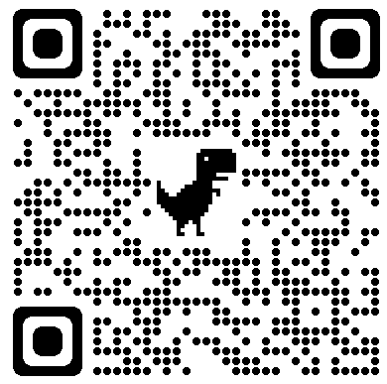
Reducing Vaccine Related Pain in Pediatric Patients
Lacey Kang, BSN, RN
Mary Ellen Connolly, DNP, CRNP
University of Maryland School of Nursing
Problem Statement
Results
Discussions
Immunization-associated pain can alter the body response to stress. Despite the development of multiple pain management techniques, many primary care offices have not adopted a form of pain management during routine immunizations. At a large urban pediatric primary care office, many parents have requested pain management during immunizations.
During weeks 5-7 all patients who were offered, received their immunizations with a Buzzy
No significant change in the the incident of patients who were offered and administered immunizations with a Buzzy
Paper documentation of data
Nursing safety concerns and hesitation with using a new device on all eligible patients
Appointment time constraints
Initial increase in adherence with Buzzy use and offering to patients consistent with evidence review
Literature review showed adequate pain management with consistent Buzzy use
Limitations
Short data collection over 11 weeks
Implementation at one office
Purpose of Project
To implement and evaluate a protocol for Buzzy use during routine immunizations in a pediatric office.
Goals:
100% of eligible patients will have been offered a Buzzy by a provider.
100% of patients who were offered a Buzzy will have received their immunizations with a Buzzy by a nurse.
Conclusions
Methods
Purchase of additional Buzzy and incorporation into EMR to promote sustainability
Buzzy use can be expanded to other primary care offices within the same healthcare system
Additional examinations of barriers to Buzzy use should be considered
Setting: large urban pediatric primary care office
Population: patients > 18 months of age receiving at least 1 immunization
Implementation:
In-person education sessions on Buzzy indications, administration, and contraindications
Educational brochures placed in exam rooms
Multiple Buzzy devices placed at nursing station
Physicians introduced a Buzzy to eligible participants and provided an informational brochure
Providers indicated on vaccine orders if the patient requested a Buzzy
Nurses prepared and administered immunizations with a Buzzy along with documentation of use
Staff education on week 1-3, project went live on week 4
100% of staff completed education by week 6
Initial education of all staff members had been achieved by week 3, however a new nurse was hired during week 5 and included in the results
No trends, shift above median starting week 3-11, 3 runs noted
There was an increase in the percentage of patients who were offered and administered immunizations with a Buzzy during weeks 3-7
Increased staff shortage and influx of patients starting at week 11
References/ Acknowledgement
Thank you to my clinical site representative Dr. Scott-McKinney

