Slide 1
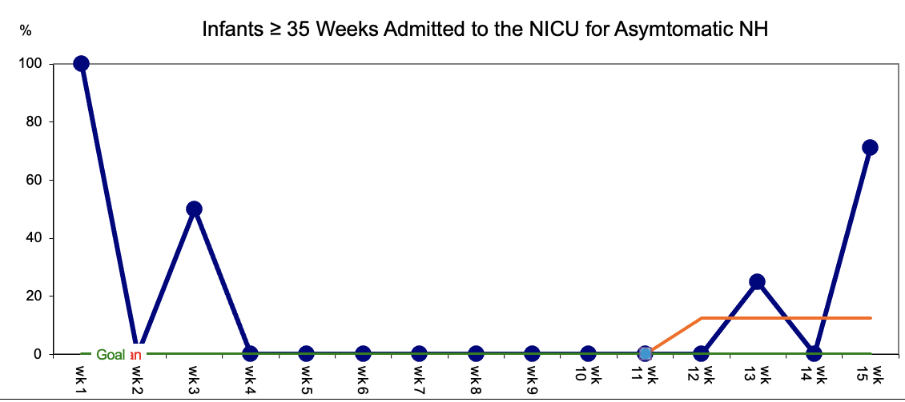
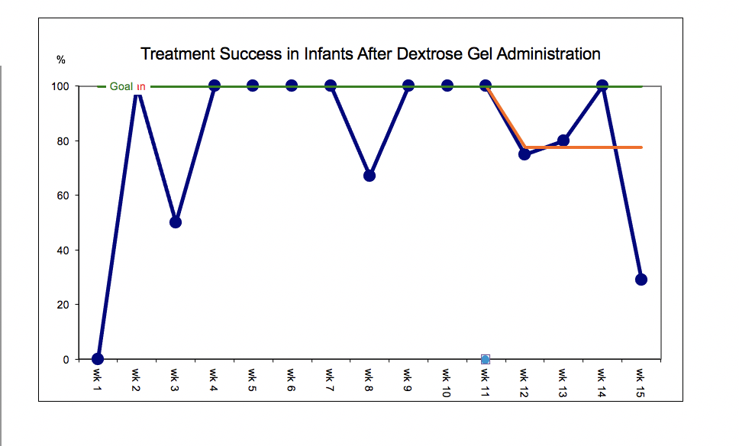
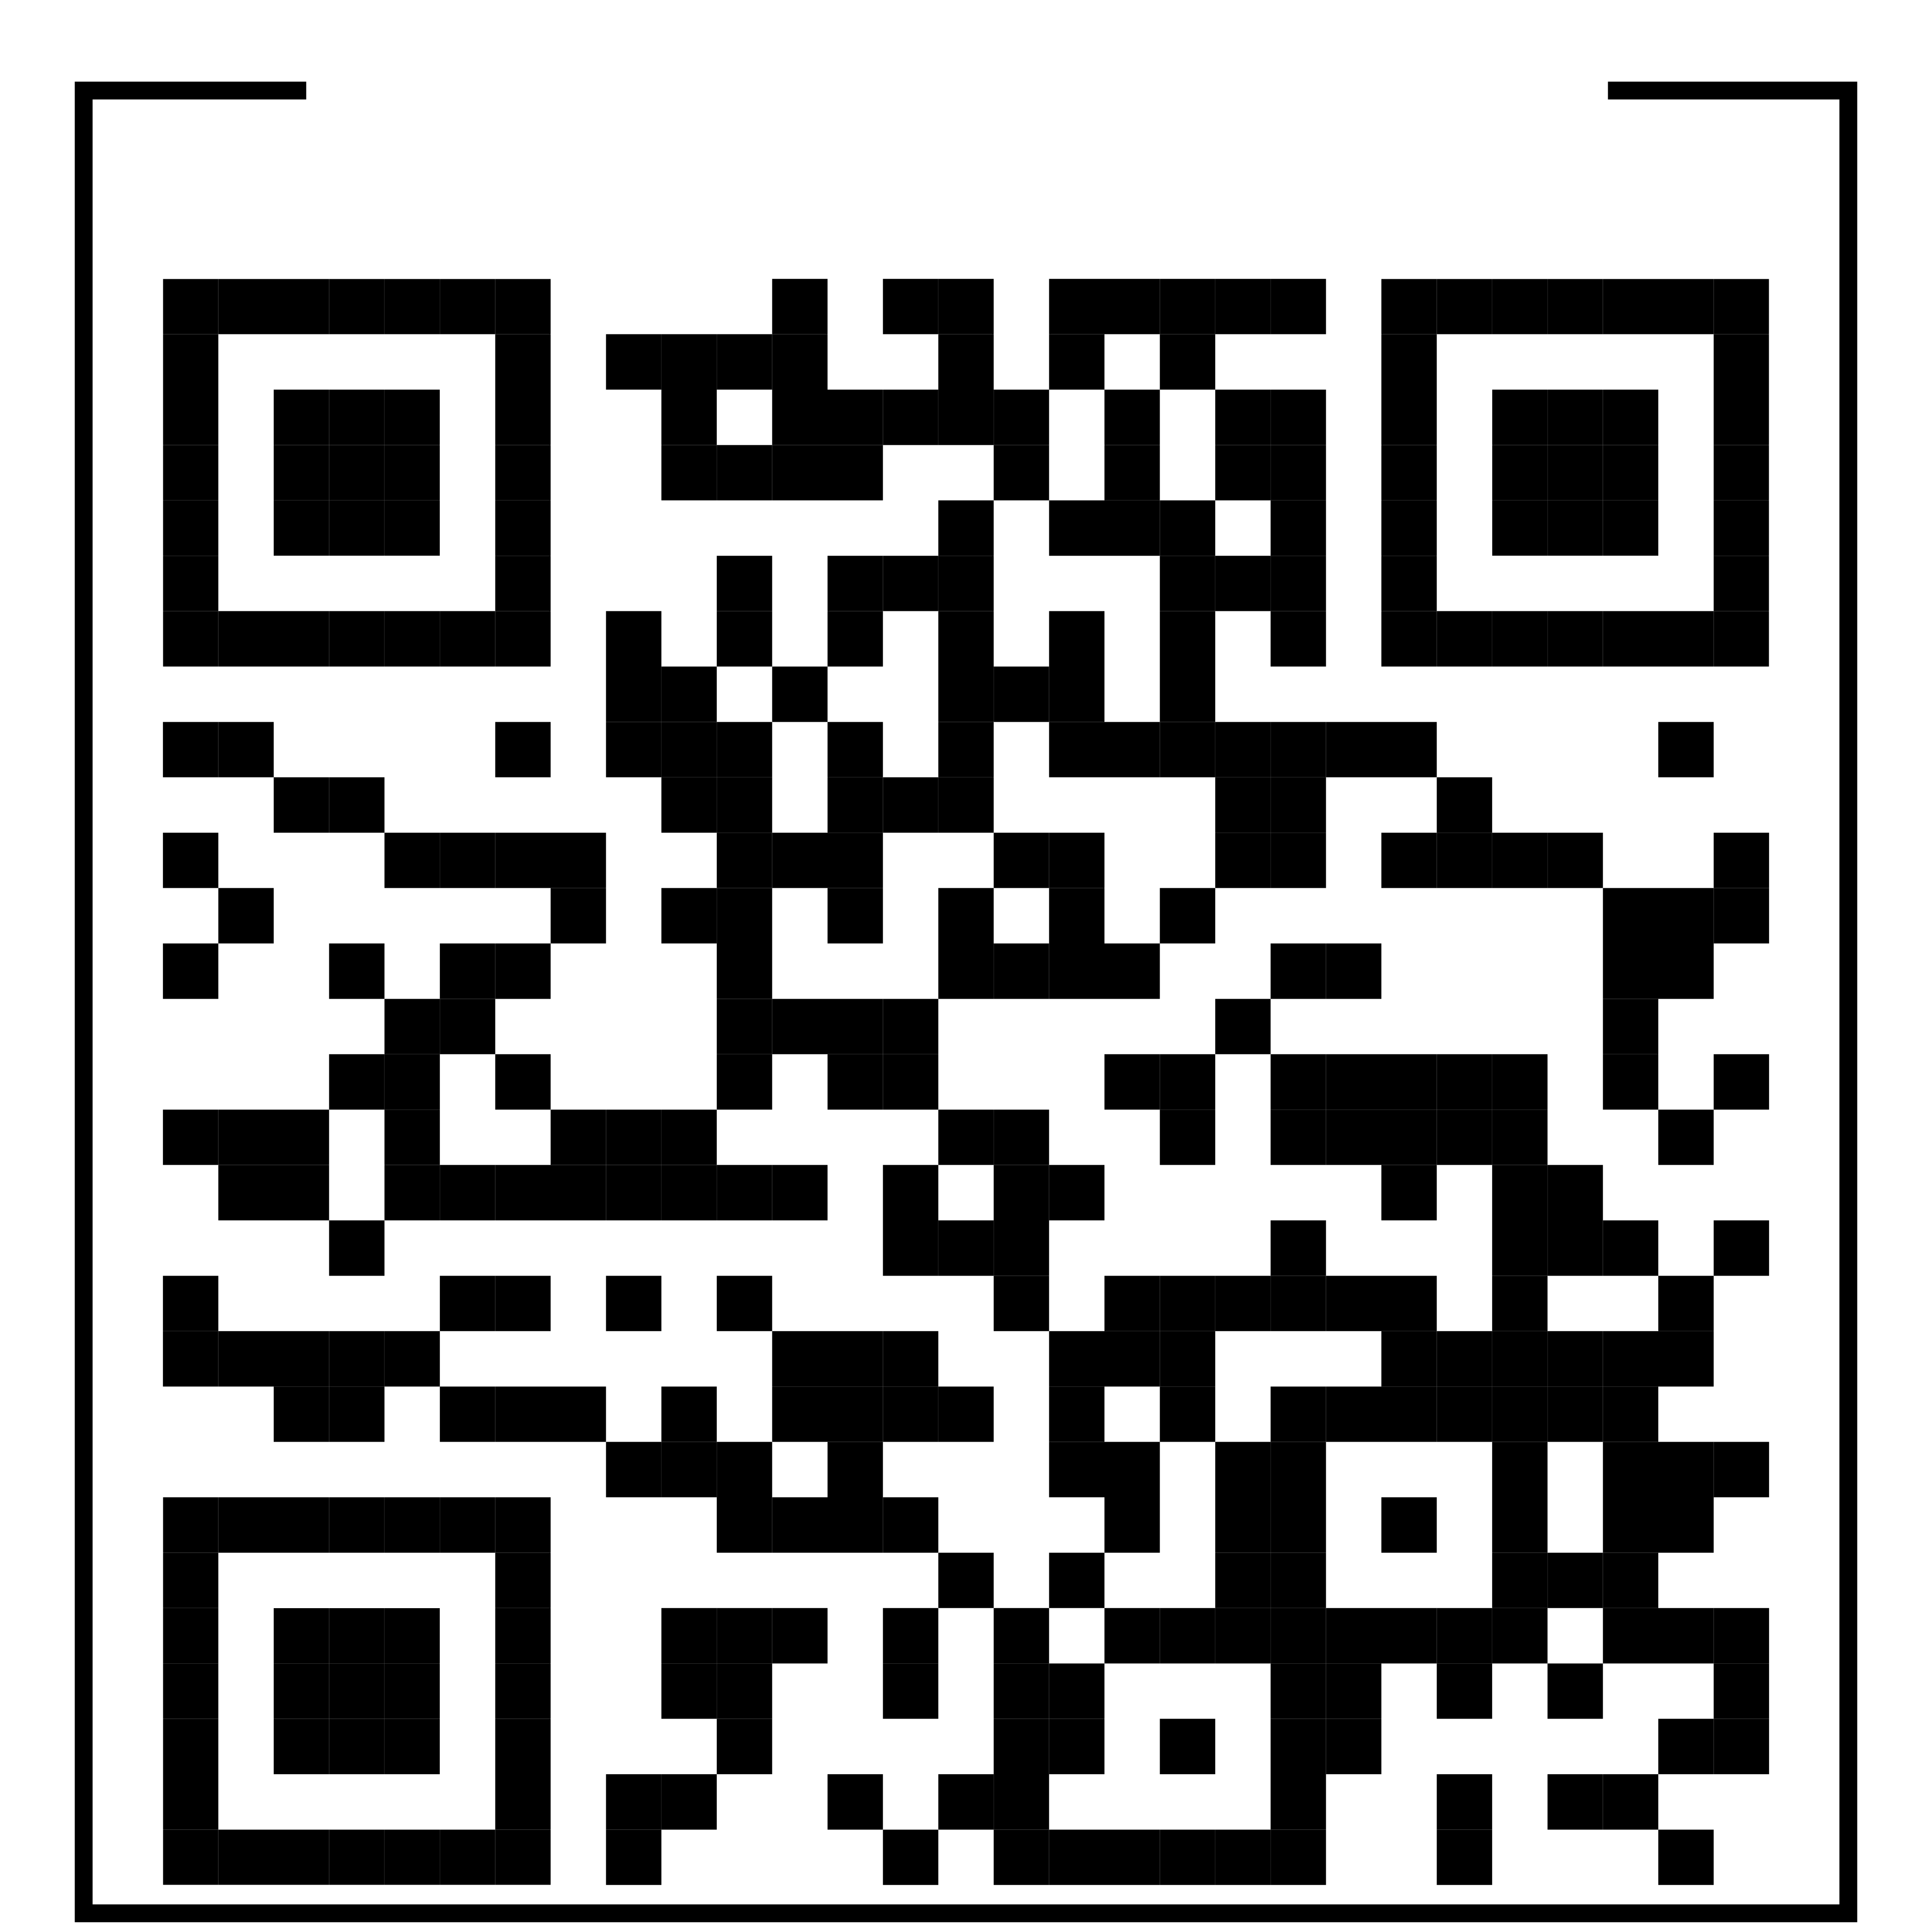
Implementation of Oral Dextrose Gel for Asymptomatic Neonatal Hypoglycemia
Kendall Vaughan, BSN, RN
Jennifer Fitzgerald DNP, NNP-BC
Barbara Wise, PhD, RN, CPNP-ACPC
University of Maryland School of Nursing
Problem Statement
Results
Discussion
Untreated Neonatal Hypoglycemia (NH) can contribute to neurodevelopmental sequalae.
Current treatment options include formula supplementation or Neonatal Intensive Care Unit (NICU) admission for intravenous (IV) fluids, leading to disruption of mother-infant dyad and infant exposure to painful procedures.
In 2020, nearly 50% of at risk newborns ≥ 35 weeks required NICU admission for NH treatment at the target institution.
40% dextrose gel is considered the standard of care for asymptomatic NH (ANH) and is currently not being used at this institution.
Overall, NICU admissions related to ANH decreased after dextrose gel implementation.
Infants were less likely to achieve treatment success and require NICU admission if blood glucose (BG) was < 30 mg/dl.
Similar to the literature, this QI project demonstrated 40% dextrose gel implementation may contribute to improved BG levels and reduced NICU admissions for ANH treatment.
Unlike the literature, improvement in exclusive breastfeeding rates was not established.
Limitations:
Small sample size.
Access issues and hospital restrictions related to the covid-19 pandemic.
High staff turn over rates, including loss of lactation consultants
Staff apprehension of oral dextrose gel
Infant’s initial blood glucose levels < 30 mg/dL
Purpose and Goals
Purpose Statement: To implement and evaluate the effectiveness of 40% oral dextrose gel, with feeds, as a first line treatment for ANH in infants ≥ 35 weeks gestation on a mother-baby unit (MBU)/newborn nursery (NBN) at an academic medical center.
Conclusions
Process Goals:
All eligible infants will be given 40% oral dextrose gel, based on the algorithm.
Outcome Goals
All eligible infants will avoid NICU admission for management of ANH.
Mothers of infants receiving treatment for ANH who desire to exclusively breastfeed will exclusively breastfeed during hospital stay
Implementation of 40% dextrose gel and an adapted algorithm was associated with an overall decrease in NICU admissions for management of ANH. Thus, increasing infant retention in the NBN and opportunity for mother-infant bonding.
79% of infants achieved treatment success
Next steps:
Increase lactation consultant participation to help improve exclusive breastfeeding rates
Transfer of project to institution staff for continued data collection
Methods
Note: On week 15, the dextrose gel algorithm was followed incorrectly - multiple patients received formula feeds for ANH prior to dextrose gel administration.
Sustainability:
Maintain and increase change champions
Inclusion of updated algorithm in new staff orientation
Incorporation into current hypoglycemia policy aids in sustainability.
Setting: 17-bed MBU/NBN at an academic medical center
Population: Infants ≥ 35 weeks gestation with ANH.
Exclusion criteria: Symptomatic NH, blood glucose (BG) < 25 mg/dL, > 24 HOL
Implementation Strategies and Measures: Implementation took place over a 15-week period in Fall 2021.
Staff educated via in-services, learning stations, an educational poster board placed in the NBN and a 13-question test.
Adaptation of existing hypoglycemia protocol to include 40% dextrose gel.
Laminated dextrose gel algorithm reference cards distributed to staff.
40% dextrose gel stocked on the unit.
Data collected weekly via data
collection forms and chart audits.
94% of staff received education on dextrose gel administration and algorithm
Dextrose gel was administered appropriately per the algorithm 88% of the time.
Implementation was associated with an overall decrease in NICU admissions related to ANH from 50% to 26%.
References
Dextrose Gel Algorithm
Acknowledgments
Treatment success = Birth-4 HOL: BG ≥40 mg/dL; 4-24 HOL BG ≥ 45 mg/dL
Dr. Jenny Yu, MD

