Slide 1


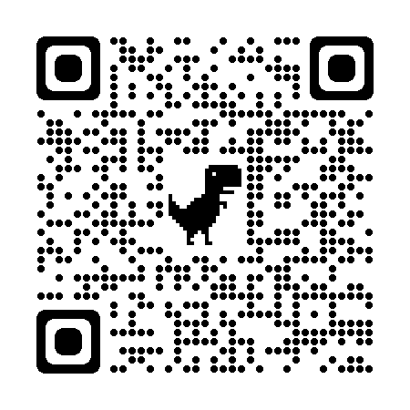
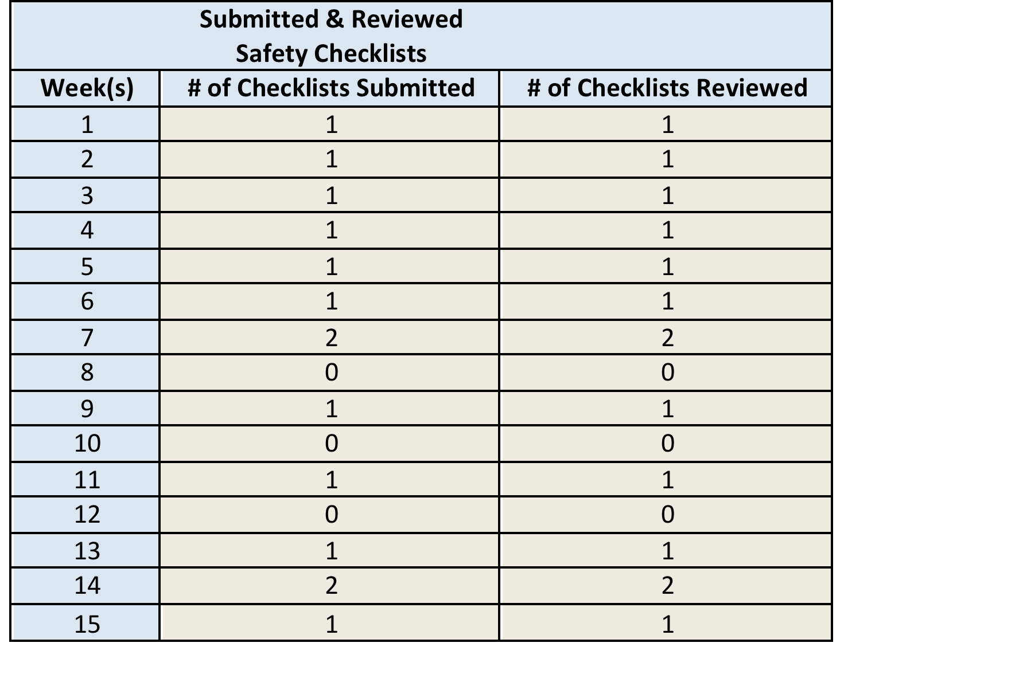
Implementation of a Safety Checklist and Guidance Tool During Well-Child Visits
Jennie Choe MSN, CPNP-AC; Marilyn Miller PhD, CRNP, CS-P
University of Maryland School of Nursing
Problem Statement
Results
Discussion
Unintentional injuries are the leading cause of morbidity and mortality in pediatrics
  12,000+ deaths per year
  9.2 million nonfatal injuries treated in emergency room per year
Pediatric providers have difficulty with injury screening and safety prevention counseling during well child visits due to:
  Lack of time during well visit appointment
  Nonstandard screening methods
  Numerous safety topics to cover
Eligible patients (n=418)
23% of eligible patients (n=95) were registered with CHADIS and received the safety screening tool
84% of the patients who received the safety tool accessed and opened the safety checklist (n=80)
17% of the patients who accessed and submitted the safety checklist (n=14)
Both process goals and one outcome goal were met by the end of the 15-week implementation period
A lack of patient registration with CHADIS was a notable barrier to the number of eligible patients receiving the safety tool
  Offering the online “quick enroll” option to register families at the office was unsuccessful
  Use of the QR code to register patients at the office was preferred
Many families were not submitting the checklist for review despite accessing the safety tool
Provider feedback supports utilization of the CHADIS safety tool due to their perceived improvement in workflow processes and the comprehensive educational content it offers for patients and families
Evidence shows that electronic safety screening tools offer:
  Thorough injury risk assessment
  Workflow efficiency
  Standardization in safety assessment and guidance
  Improvement in parental knowledge and behaviors towards safety
  Evidence-based updates in pediatric safety for providers and families
Limitations:
  COVID-19 pandemic limited office visits due to changes in scheduling and unwillingness of families to go to the clinic
  Staffing shortages
  Patient registration with CHADIS remained difficult from the start of implementation
Purpose & Goals
To implement the pre-visit electronic Safety Checklist and Safety Guidance Tool developed by CHADIS (Comprehensive Health and Decision Information Systems) at a pediatric clinic to provide:
  A standard and comprehensive approach to injury risk screening relevant to the developmental age of the child
  Focused safety guidance to caretakers
  Improve workflow efficiency by saving time during the well-child visit
Process Goals: (Prior to implementation of the safety tool)
Make the safety tool available for eligible patients to access and complete
Make the safety tool available for pediatric providers to access, view, and analyze results of completed checklists
Outcome Goals:
Eligible patients will complete the safety tool through their CHADIS patient portal prior to their appointment
Providers will review and discuss results during the well child visit
100% of providers completed training on the CHADIS Safety Checklist and Guidance Tool
100% of submitted safety checklists were reviewed by the providers and discussed during the patient’s well child visit
Conclusions
Methods
Implementing the electronic CHADIS safety tool can offer thorough injury risk screening and focused guidance to families without interrupting workflow processes during well-child visits
Setting: Small, urban community pediatric practice
Target Population: Infants and children ages 0 to 10 years of age for routine well child visits
Implementation Strategies:
Use of QR code and “quick enroll” patient CHADIS registration
Pre-visit auto-assignment of age-specific safety checklists to eligible patients through their CHADIS patient portal
Electronic safety guidance provided to patients upon completion of the checklist for review
Providers review completed checklist results in CHADIS to discuss focused safety guidance with families during visits
Implementation Tactics:
Identifying and preparing site champions, staff education, assessment for implementation readiness, technical assistance and clinical support, identification of barriers and facilitators, routine meetings and reminders
The CHADIS safety tool is valued by staff and providers, making it more likely to be sustained and utilized at other practices that use CHADIS
Facilitates workflow processes by decreasing the time spent on screening and discussing safety prevention during well visits
Future QI projects may include:
  A longer implementation trial period for the safety tool
  Getting families registered with CHADIS and understanding barriers to registration
References

