Slide 1
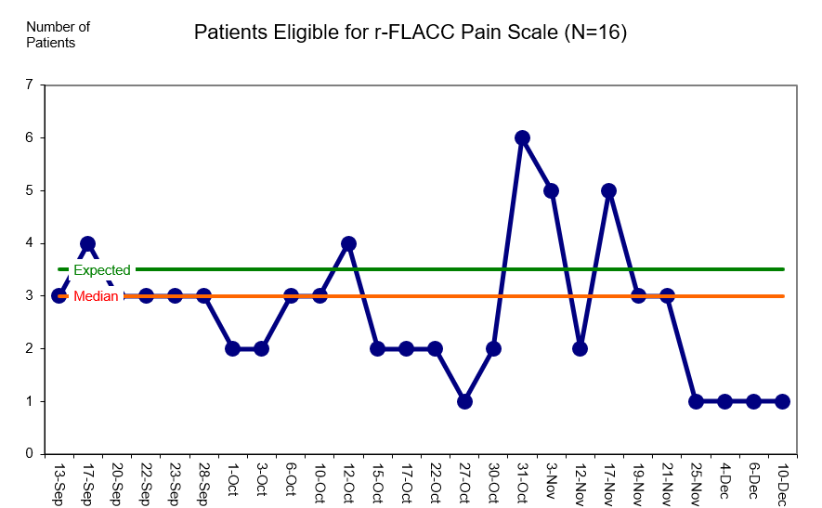
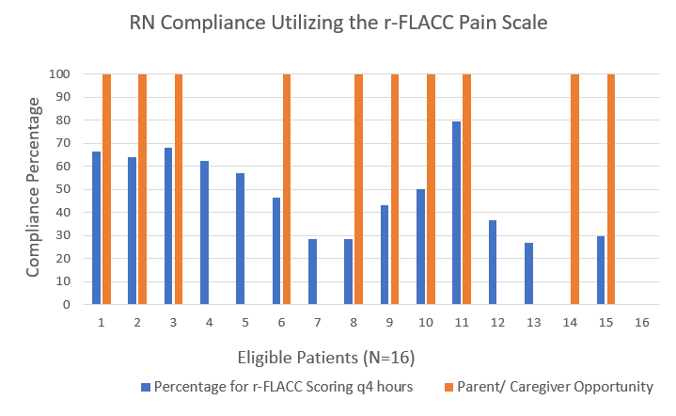
Implementation of the revised-FLACC Observational Pain Scale on a Pediatric Unit
Amanda Hansen BSN, RN, CPN
Shari Simone DNP, CPNP-AC, FAANP, FCCM, FAAN
University of Maryland School of Nursing
Problem Statement
Results
Discussion
The national rate of children (3- 17 years) diagnosed with developmental disabilities is 17.8% and increasing
Children with developmental delays, cognitive impairments, and intellectual disabilities are more likely to receive specialty care leading to frequent hospitalizations and surgeries.
This population has atypical pain behaviors and cannot self-report pain and are at risk for the under recognition and treatment of pain.
On a pediatric medical-surgical unit, the current standard pain assessment for patients unable to self-report is the FLACC scale. The revised-FLACC (r-FLACC) is a validated and reliable tool tailored to assess pain in this population and offers the opportunity for parent or caregiver input.
On average 3 patients, of a 20-patient census, were eligible to use the r-FLACC pain scale daily
r-FLACC pain scores were correlated, but significantly higher than concurrent FLACC scores
Overall RN r-FLACC scoring compliance: 49%
Parents/ caregivers given the opportunity to individualize the scale upon admission: 67%
Parent/ caregiver anonymous surveys successfully completed: 19%
All reported satisfaction with the r-FLACC pain scale and their child’s pain management and treatment.
Barriers: scale not included in the electronic medical record, high patient acuity, use of supplemental RNs, caregivers not present, language barriers, guardianship issues, complex discharges, & incomplete surveys
Most common pain interventions reported by RNs (most to least): medication (31), repositioning (25), rest/ distraction (17), heat or cold (1).
Limitations:
Constantly evolving unit census
Paper scores accidentally discarded
Small sample size; however, large number of observations
Prior census data estimated 3-4 patients per week would be eligible for the r-FLACC pain scale!
Purpose & Goals
Purpose Statement: To implement and evaluate the r-FLACC pain scale for assessing pain in pediatric patients with developmental delays, intellectual disabilities, and cognitive impairments.
Goals:
Eligible patients will be scored using the r-FLACC every 4 hours by nurses
Parents/ caregivers of eligible patients will be given the opportunity to individualize the r-FLACC pain scale
Parents/ caregivers of eligible patients will report satisfaction about their child’s pain control
Total r-FLACC observations (n) = 465
Mean Scoring Compliance= 49%
Parents/ Caregivers Opportunity Compliance= 67%
Conclusion
The r-FLACC pain scale adequately captured this pediatric population’s pain and caregivers were satisfied with their child’s pain management. Results suggest the r-FLACC pain scale is the most appropriate pain scale for children with developmental delays, intellectual disabilities, and cognitive impairments agreeing with previously published evidence.
Next Steps: Integration of the r-FLACC pain scale in the electronic medical record to be used across all pediatric areas.
Methods
Note: Two patients excluded in compliance analysis due to missing data.
Setting: 20-bed inpatient pediatric medical-surgical unit
Population: Children with developmental delays, cognitive impairments, and intellectual disabilities prohibiting pain self-report
Intervention:
Incorporating the r-FLACC into daily practice included:
Providing the opportunity for parent or caregiver involvement upon admission using a self-made Nurse Admission Guide & hands-on r-FLACC pain scale
Documenting the r-FLACC pain score and pain intervention on paper every 4 hours in addition to the concurrent FLACC score electronically throughout the admission
Assessing parent/ caregiver perception and satisfaction anonymously
Strategies/ Tactics:
Announcements, reminders, re-education, and identified facilitators/ barriers → face-to-face, email, ‘huddle’ announcements, monthly staff meeting minutes, electronic medical record ‘sticky note’ feature
Staff incentives
Unit champions
r-FLACC vs. FLACC
t-Test: Paired Two Sample for Means
 | FLACC | r-FLACC
Mean | 0.2667 | 0.3204
Variance | 1.2563 | 1.4381
Observations | 465.0000 | 465.0000
Pearson Correlation | 0.9160
Hypothesized Mean Difference | 0.0000
df | 464.0000
t Stat | -2.4069
P(T<=t) one-tail | 0.0082
t Critical one-tail | 1.6481
P(T<=t) two-tail | 0.0165
t Critical two-tail | 1.9651
Data includes 465 observations where both the FLACC and r-FLACC were both collected across 15 patients.
The mean FLACC score was .2667 on a 0–10-point scale.
The mean r-FLACC score was .3204 on a 0–10-point scale.
The mean difference between FLACC and r-FLACC scores was approximately 0.05 points.
FLACC and r-FLACC scores were highly correlated at .916 (p < .001).
References
SCAN ME!
On average, nurses reported significantly higher pain scores using the r-FLACC than the FLACC (t = -2.406, df = 464, p = .016).

