Slide 1
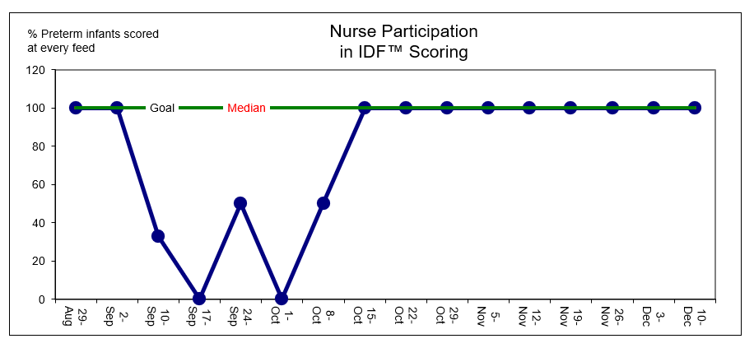
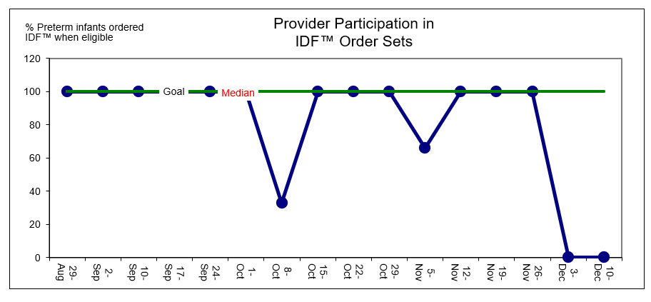
Implementation of Infant Driven Feeding™ Program
Allison Groff BSN, RN
Mary Ellen Connolly DNP, CRNP
Shari Simone, DNP, CRNP-AC, FAANP, FCCM, FAAN
University of Maryland School of Nursing
Problem Statement
Results
Discussion
Premature birth occurs in 1 in 10 infants in a mid-Atlantic state
Preterm infants require significant support to maintain their nutritional requirements and achieve full oral feeding.
Inconsistent feeding practices is a barrier to reaching oral feeds
Time to achieve full oral feeds from initiation of oral feeds for pre-term infants 33-weeks gestational age and greater is 4 days at baseline.
Structure goals met
Guideline created
Education of NICU staff 100%
Process goals met
100% of readiness scores completed in the last 6 weeks
100% of provider orders are in place 11 out of the 15 weeks
Outcome measure does not show a decrease in the average number of days to achieve full oral feeds compared to baseline data.
Literature showed time to achieve full oral feeds in the NICU was 4-6 days shorter among preterm infants fed in response to feeding and satiation cues compared to preterm infants fed at prescribed amounts
Limitations include:
Small Sample Size
Different gestational ages at birth between the pre-implementation group and post-implementation group
Purpose and Goals
Implement and evaluate the use of the Infant Driven Feeding™ (IDF™) program over a 15-week period to decrease the amount of time from initiation of oral feeds to full oral feeds among preterm infants in the neonatal intensive care unit (NICU).
Short-Term Goal: 100% of preterm infants in the NICU will receive milk by nurses according to IDF™ guidelines as ordered by the providers.
Long-Term Goal: Preterm infants in the NICU fed according to IDF™ guidelines will achieve full oral feeds from initiation of oral feeds more efficiently than at baseline.
Conclusion
IDF™ did not result in fewer days to achieve full oral feeds
Provided a common language to discuss feeding progress and allowed further nurse autonomy when an IDF™ order was in place.
Spread and sustainability
Ongoing tracking and auditing
Annual refresher course for nurses and providers
IDF™ in Nurse Competency checklist
Next steps include:
Integrate IDF™ order sets into EPIC for easier provider use
Consider another QI project to determine if better outcome data can be acquired
Methods
Setting: 18-bed level IIIB NICU in a community hospital
Target Population: Preterm infants 33 weeks and greater
Implementation:
Education of NICU staff on IDF™
Development of IDF™ guidelines
Data was extracted from the electronic medical record (EMR) for analysis.
IDF™ order in place by provider (yes/no)
IDF™ score at each feed by nurse (yes/no).
Length of time to full oral feeds after initiation of first oral feed (days).
IDF™ Website
Acknowledgment/References

