Slide 1
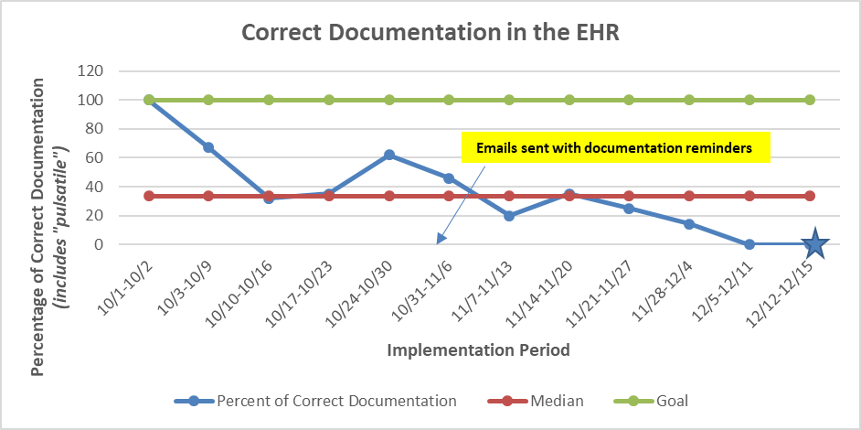
Implementation of a Pulsatile Flush Procedure for Central Line Maintenance
Erin Kenny, BSN, RN, DNP Candidate
Dr. Barbara Wise, PhD, RN, CPNP-AC/PC
University of Maryland School of Nursing
Problem Statement
Documentation inconsistency
39% decrease in TPA administered (compared to baseline data Aug-Sept)
Limitations/Barriers:
Covid-19
delay in IRB approval
no standardized order
lack of EHR build out for documentation
5 million central venous catheters are placed each year increasing risk of occlusion and infection
Evidence supports push-pause pulsatile flushing
Normal saline solution is a safe and effective alternative to heparin solution
On a pediatric cardiac ICU (PCICU), tPA was administered 106 times within 6 months
0 lines were receiving normal saline with pulsatile flushing for central line maintenance
Discussion
Purpose of Project and Goals
Conclusions
Purpose: Implement and evaluate normal saline (NS) for locking and flushing central lines with a pulsatile technique
Process Goal:
By November 15th, 2021, 100% of CVC will be flushed with NS using pulsatile method
By November 15th, 2021, 100% of line documentation will include free text “pulsatile flush”
Outcome Goal:
By December 15th, 2021, 100% decrease in TPA administered for clot formation in CVCs.
Implementing normal saline flush with pulsatile procedure is feasible
Similar to the literature, there was no increase in the total number of TPA administrations or CLABSIs
Sustainability Strategies: built into new hire education, standardized order, EHR documentation, implement on another unit
References
Methods
Boord, C. (2019). Pulsatile flushing: A review of the literature. Journal of Infusion Nursing, 42(1), 37-43. https://doi.org/10.1097/NAN.0000000000000311
Goossens, G. (2015). Flushing and locking of venous catheters: Available evidence and evidence deficit. Hindawi Publishing Corporation Nursing Research and Practice. https://doi.org/10.1155/2015/985686
Setting: 12 bed-Pediatric Cardiac ICU, in mid-Atlantic region
Population: Cardiac patients with a CVC, ages 0-21
15 week period, September-December 2021
Reference tables at bedside, heparin flushes removed from bedside carts
Sign off with in person education, informational PowerPoint, email with practice change reminders, notes on unit
Data collected manually daily by chart audit on a secured analytic framework
Results
264 central line days, 242 (92%) received pulsatile saline flushes
30% adhered to documentation bundle
2% received TPA for line occlusion
Remained CLABSI free
Acknowledgements
Special thank you to Jennifer Fitzgerald, DNP, NNP-BC and Katie Thompson, DNP, RN, ACCNS-P, CCRN for their support.
Notes:
Evidence supports push-pause pulsatile flushing method to prevent occlusion and remove debris from CVC for all patient populations
Using pulsatile flush and saline led to a 39% decrease in TPA administered overall on unit compared to baseline data in August and September
Documentation inconsistency to include pulsatile free text, saline locked was selected, nurses not adhering to free text
Sustainability: education material for staff and integrate into new hire education, finalizing standardized pulsatile flush order, EHR build out, recommendation to implement on another unit

