Slide 1
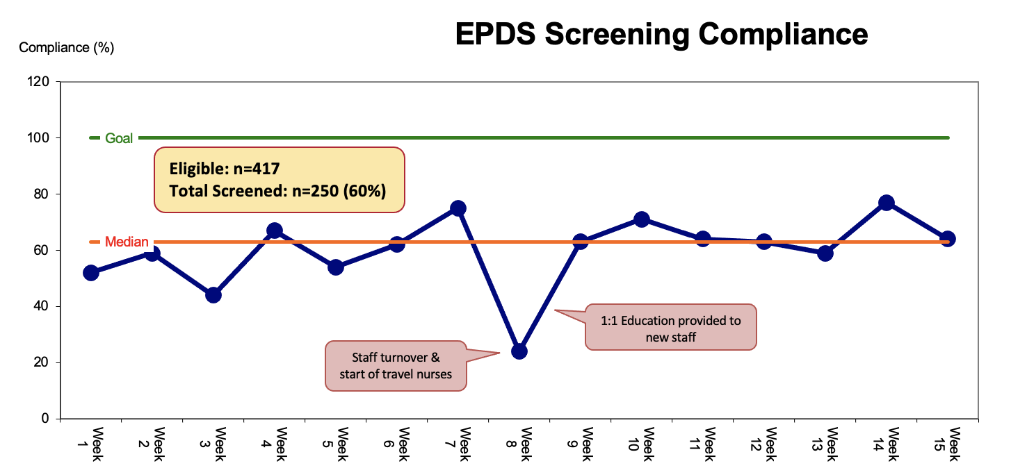
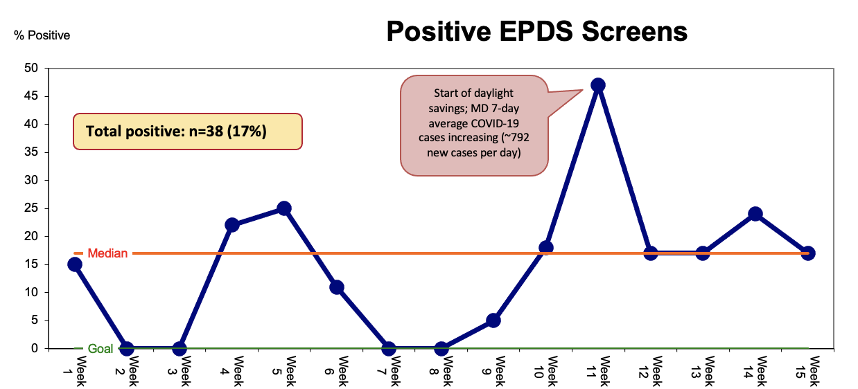
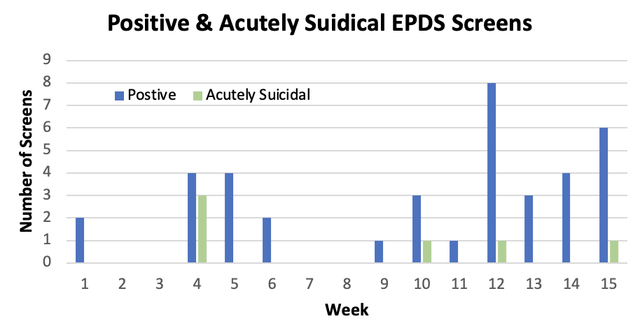
Postpartum Depression Screening in the Pediatric Emergency Department
Crystal Furr, BSN, RN;
Shari Simone, DNP, CPNP-AC, FAANP, FCCM, FAAN
University of Maryland School of Nursing
Problem Statement
Results
Discussion
1 in 8 women experience symptoms of postpartum depression in the U.S.
In Maryland, 60% of mothers report signs & symptoms of postpartum depression; only 8% diagnosed and treated
Long-lasting negative impacts on mother and child including premature discontinuation of breastfeeding, and delayed development
90% higher healthcare costs attributed to mental health and emergency department visits by both the mother and child
Screening using the Edinburgh Postnatal Depression Scale (EPDS) - a validated, self-reporting tool – reveals postpartum depression is as high as 27% with 7% of mothers reporting suicidal thoughts in the pediatric emergency department
Project was successful in identifying mothers with signs and symptoms of postpartum depression
Positivity rate was 17% - comparable to findings from other PEDs that implemented postpartum depression screening with the EPDS tool
Social work is an integral part of screening in this setting, and can provide community resources for mothers based on needs
Facilitators:
Personal experiences with postpartum depression by staff nurses
Organization’s Baby-Friendly designation
Barriers & Limitations:
High nursing turnover and staff shortages during implementation
Screening done on paper (lost completed screens)
No automatic electronic documentation reminder for nurses
Limited mental health providers & appointment availability in area
Purpose & Goals
Purpose Statement: to implement postpartum depression screening in a pediatric emergency department (PED) using the EPDS and provide referrals for formal diagnosis and treatment to those who screen positive.
Conclusion
Short Term Goals
PED nurses will administer and evaluate the EPDS screening tool in 100% of the eligible patients’ mothers
100% of mothers with a positive screen receive a social work referral for mental health resources
Create an electronic medical record dot phrase for nursing documentation of the completed EPDS
Long Term Goals
Integrate a best practice advisory for postpartum depression screening into the electronic medical record
Screening for postpartum depression using the EPDS in the PED is achievable. At-risk mothers were identified, and social work was able to provide mental health & community resources prior to discharge.
The PED serves as an opportune setting for postpartum depression screening due to the availability of social work and psychiatric emergency services
Mothers were accepting of the screening and willing to see a social worker about available resources in the community
Sustainability:
Implementation of a best practice advisory into the EMR
Designated space within the EMR to document results – a positive screen should automatically alert social work
Implications for future practice:
Organizational administrators track use of resources provided to the mother while in the PED with follow-up phone call or email
Methods
Setting: 20-bed PED in a large, tertiary care academic medical center
Population: Mothers of non-critically ill patients under 12 months of age
Intervention:
Postpartum depression screening using the EPDS
PED nurses collected and scored the tool
Results were recorded in the electronic medical record using a dot phrase
A positive screen was a score ≥ 10 or a positive answer to the suicidal ideation question
If the screen was positive, a social work referral was completed
Social work evaluated and provided mental health resources
Compliance and positivity rate tracked via weekly chart audits
Social work provided resources 97% of the time (only one missed opportunity)
Acknowledgements
16% of positive screens were acutely suicidal!
A special thank you to the PED nurses and social workers who made this project possible.
SCAN ME!
References
Link to sample EPDS screening tool used at UCSF
For a complete list of references, please scan the QR code below:
Tactics:
Staff education on EPDS administration and evaluation
Bi-weekly data reports to staff
Identification of barriers and facilitators throughout implementation
Staff incentive for compliance

