Slide 1
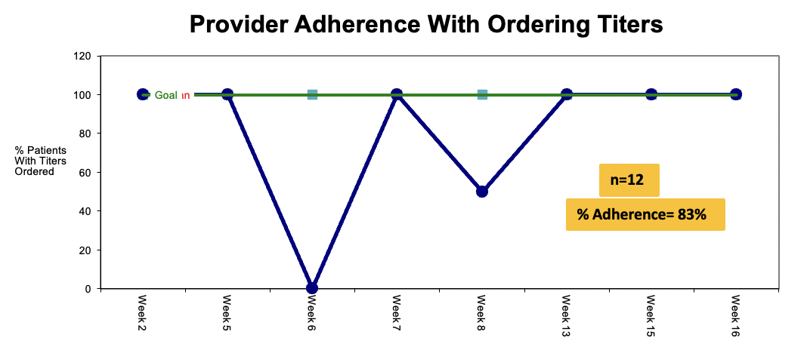
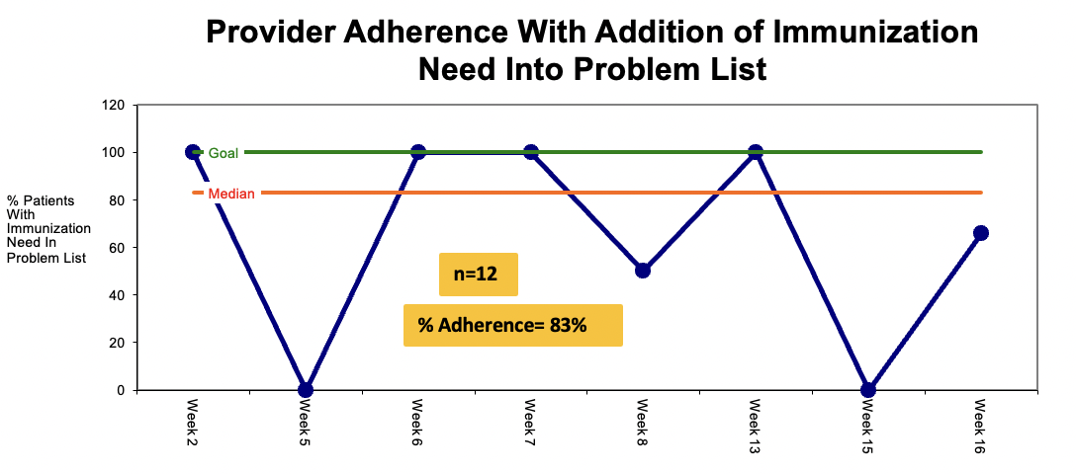
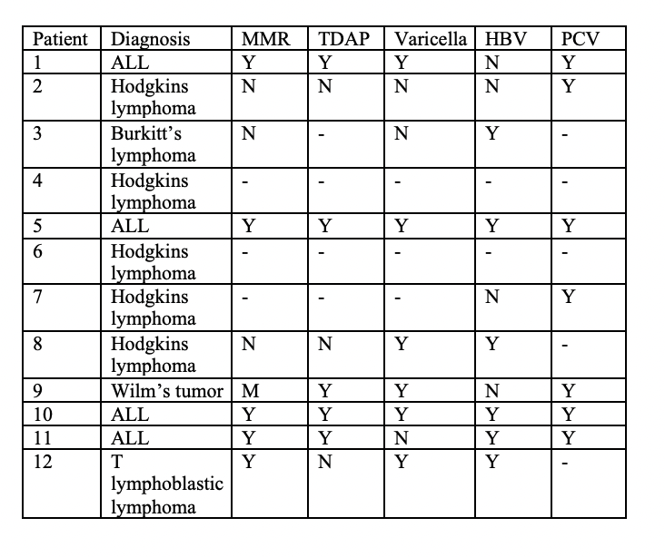
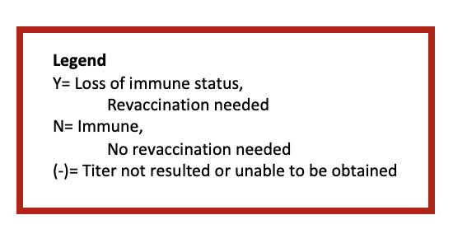
Development of a Pediatric Post-Chemotherapy Vaccination Protocol
Samantha R. Burley BA, BSN, RN, CPN
Shari Simone DNP, CPNP-AC, FAANP, FCCM, FAAN
Holly Warren Deluca MSN, CRNP, CPHON
University of Maryland School of Nursing
Problem
Results
Discussion and Limitations
Pediatric oncology patients are at a high risk for acquiring vaccine-preventable diseases
This project successfully identified post-chemotherapy reimmunization needs, vaccination plan, and follow-up communication with the primary care provider in a sample cohort of patients.
Why?
Previous immunocompromised status
Loss of protective titers following chemotherapy treatment
Only 48% of providers nationwide assess immune status prior to revaccination and re-vaccination time frame ranges from 6-18 months.
This inconsistency is mirrored within an urban pediatric oncology clinic, leading to children with unnecessary and prolonged vulnerability to vaccine-preventable diseases.
Barriers | Facilitators
Hemolyzed blood samples | Project champions
Insufficient blood quantity | Provider support
100% of patients required revaccination to at least one or more vaccine-preventable diseases (Table 1).
Of the 6 patients with fully resulted titers, 33% (2 patients) needed complete reimmunization with the MMR, TDAP, varicella, hepatitis B, and pneumococcal vaccines (Table 1).
Figure 1. Weeks 1, 3, 4, 9, 10, 11, and 14 excluded due to lack of eligible patients
Purpose and Goals
Purpose Statement: To implement an evidence-based standard of practice for re-immunization of pediatric oncology patients following completion of chemotherapy treatment
Conclusions
Goals:
100% of eligible patients have total IgG and the following titers ordered:
100% of eligible patients have reimmunization added to their electronic medical record problem list
100% eligible have a standardized letter with revaccination plan sent to their primary care provider
This project successfully identified pediatric oncology patient’s need for re-immunization following chemotherapy. Results suggest that 6 months is the appropriate time for re-assessment of immune status via titers.
MMR | Varicella | Hep B Surface Ag | Tetanus/ Diphtheria | Pneumococcal
This project successfully highlights one way to communicate with patient’s primary care provider but cannot guarantee that the patient received the vaccinations recommended by the providers.
Future Implications:
Implementation of the developed protocol into the organization’s policy database.
Exploration of results regarding diagnosis and loss of specific titers in a research project of longer duration.
Figure 2. Weeks 1, 3, 4, 9, 10, 11, and 14 excluded due to lack of eligible patients
Methods
Table 1. Immunization needs of post chemotherapy patients (n=12)
Setting: Outpatient pediatric oncology clinic in a large academic teaching hospital
Population: Children ages 4y-21y, diagnosed with cancer since
2013, that have completed chemotherapy at least 6 months prior to implementation period
Intervention:
Implementation of a formal protocol detailing the vaccine titers to be obtained based on current evidence over a 16-week period
Use of a of a template (.revax) for standard electronic documentation of revaccination need inputted into patient problem list
Use of standardized letter (.pcpletter) with revaccination plan for primary care provider
Strategies/Tactics:
Reminder emails 1-3 days prior to the patient’s visit with protocol attached
Identification of barriers and facilitators throughout project
Acknowledgements
A heartfelt thank you to the following individuals for their unending dedication and support:
Diane Keegan Wells MSN, RN, CPNP, CPHON
Regina Macatangay, MD
Ashley Munchel, MD
Teresa York, MD
Ricki Weisbrot DNP, RN, CPNP-AC
UMSON Pediatric Acute Care DNP Class of 2022
Scan Me!
for the Immunization Protocol
References
Scan Me!
for the PCP letter template
100% of patients with fully resulted titers had standardized letter with revaccination plan sent to their primary care provider!
Scan Me!

