Slide 1
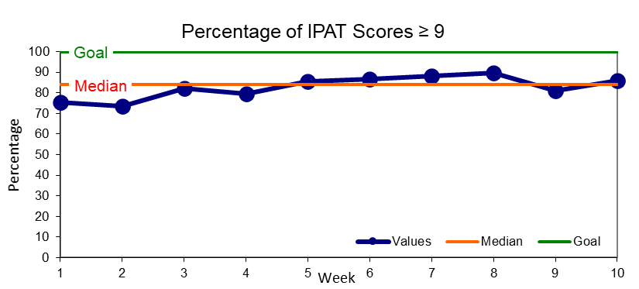
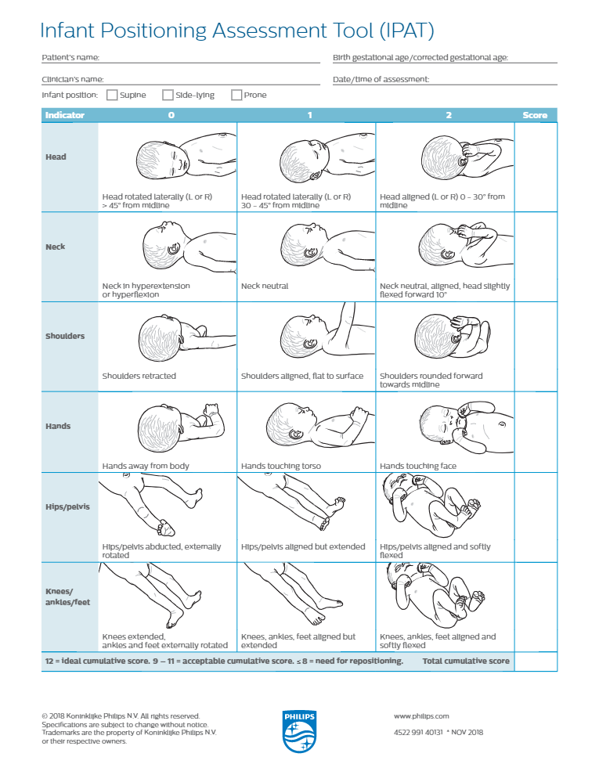
Implementing the Infant Positioning Assessment Tool in a Neonatal Intensive Care Unit
Ivanna Buchynsky, MSN, RN, CNL; Mary Connolly, DNP, CRNP; Shari Simone, DNP, CRNP, FCCM, FAANP; Lisa Baloh, OTR/L, MBA, CNT, NTMTC, CEIM
Problem Statement
Results
Discussion
Infants in the neonatal intensive care unit (NICU) are at increased risk for long-term complications and disability
Standardized developmentally supportive positioning practices in the NICU improve patient neurodevelopmental outcomes
The Infant Positioning Assessment Tool (IPAT) is a valid and reliable standardized pictorial NICU tool
In one academic community medical center NICU, no standardized developmentally supportive positioning guideline was in place
This unit positioned 75.1% of infants in a developmentally supportive manner
Goal of 100% of infants to have an IPAT score ≥ 9 by completion of the QI project was not achieved
Increase was seen in the percentage of acceptable IPAT scores when comparing the baseline (75.1%) to the average (82.8%) and median (83.9%)
Limitations:
Data collection period of 10 weeks
Low NICU caregiver educational training module completion rate (23.2%)
Semiweekly spot checks outside of care times by one nurse
Lack of electronic health record (EHR) involvement
Baseline: 75.1% Average: 82.8% Median: 83.9%
Purpose of Project
Conclusion
Purpose: Implement the IPAT to improve consistency in developmentally supportive positioning.
Goal: 100% of eligible patients to have an IPAT score of greater than or equal to 9 by completion of the implementation period.
Results indicate a positive change in developmentally supportive positioning practices on the unit
Implementation of the standardized IPAT positively impacts consistency in developmentally supportive positioning practices at the project site
Recommendations:
Integrate the IPAT into the EHR
Encourage completion of the NICU caregiver educational training module
Expand module access to NICU interprofessional team
Integrate developmentally supportive positioning training and use of the IPAT in new staff orientation and annual competencies
Methods
Setting: 26 bed, Level III NICU from November 2021 to January 2022
Population: Infants over 32 weeks gestation,1,500 grams, past 72 hours of life, and admitted to the unit for more than one 12-hour shift
Intervention:
IPAT bedside reference
Two-point scoring system for six areas
IPAT ≥ 9 indicates acceptable positioning
IPAT < 9 indicates need for repositioning
Online educational training module
Informational reference posters
Ongoing bedside education
Data Collection: Averaged weekly percentage of infants with IPAT total cumulative scores of greater than or equal to 9
References

